Slide 1



OPAL Tools
Free Tools for Oracle Software Development
Dietmar Aust Opal-Consulting, Cologne
www.opal-consulting.de

Slide 2
Agenda
WHY? Background / Context
The Solution
Demo
Customization
Download / GitHub

Slide 3
WHY? Background / Context
Notes:
Drag your picture and Send to Back

Slide 4
WHY? Background / Context
20+ years of custom development for Oracle: PL/SQL, SQL, Forms, Reports, APEX, have seen very different approaches
Typical project has multiple environments, e.g.:
Development
Test
Production
… or even more
Manage sources differently
SQL and PL/SQL objects (1:1 in database)
„Manual“ scripts (e.g. alter table add column or generate synonyms, grants and views on the fly)
Other sources (Java, shell scripts, node.js, …) possible but out of scope

Slide 5
WHY? Background / Context
Different people use different workflows
The database is the master – with or w/o version control
The file system is the master – typically with version control
A mix of the two (working alone most of the time and/or forgot to use the file). Easy synchronization would be nice.
Different projects – different tools
Cannot rely 100% on a specific tool
Most tools don‘t work well on the command line (either calling and/or customizing them)

Slide 6
The Solution
Notes:
Drag your picture and Send to Back

Slide 7
The Solution
The software:
Written in Java + (generated) batch scripts
Works on Windows, MacOS and Linux
Exporter leverages DBMS_METADATA and SQLcl
Installer leverages SQLcl
Tools can be used together … OR separately
Java application opal-export
Java application opal-install
DBMS_METADATA
SQLcl
SQLcl

Slide 8

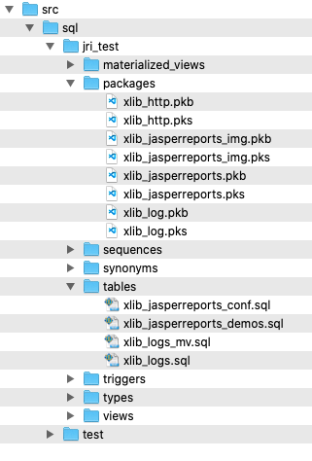
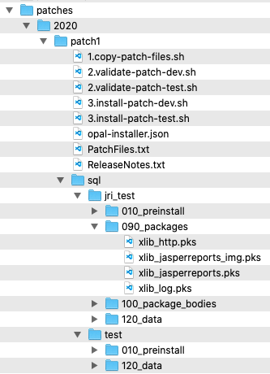
The Solution
Source Files
Patches
install
Test
Export with
DBMS_METADATA
copy files
or
reference files
e.g. @../packages/util.pks
Development
install
Export:
Database Objects
APEX applications
ORDS modules
Custom spool scripts
Patch / Deployment:
SQL scripts
Executed with SQLcl
Production
Patch Installation can be automatically registered

Slide 9
The Solution
Tools can be used together … or separately
Usages
Initial seed of database objects into the file system
Continuous export of database objects
Goal? Don‘t force a specific approach, rather support existing styles and improve the quality
No point in having a PERFECT approach that isn‘t widely used.

Slide 10
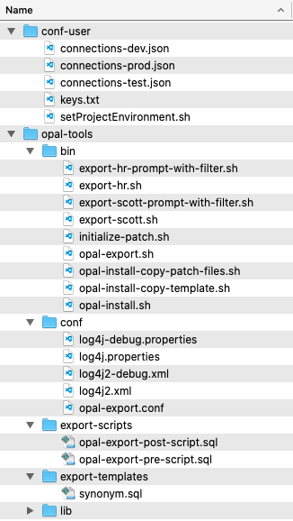
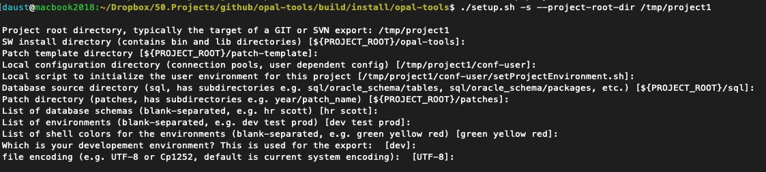
The Solution
E.g. run setup for schemas HR and SCOTT and environments dev,test,prod
Folder „conf-user“
Typically outside of GIT / SVN repository

Slide 11
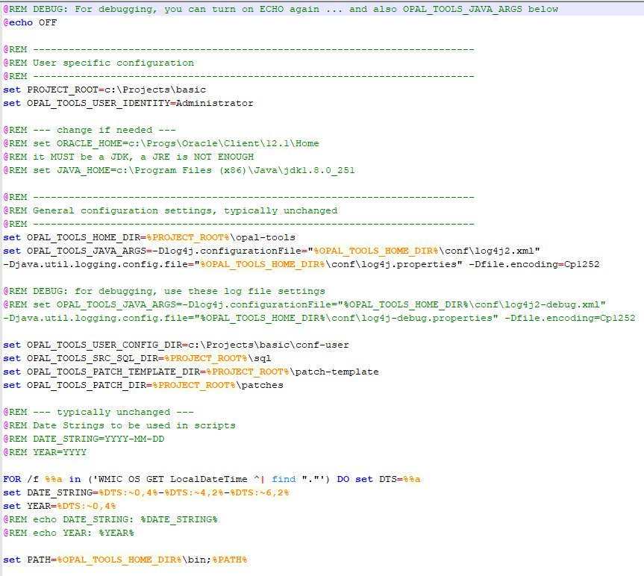
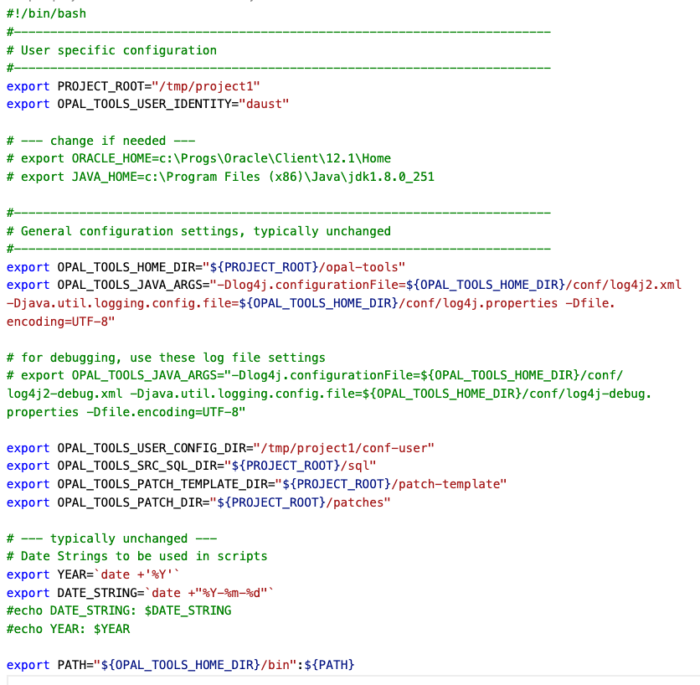
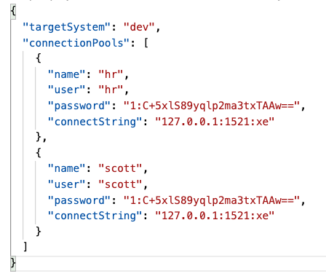
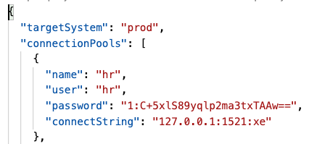
The Solution
setProjectEnvironment.sh / cmd
connections-dev.json
Support for:
Proxy Accounts
Cloud Database
connections-prod.json

Slide 12
The Solution
Folder „opal-tools/bin“
Contains scripts to call the Java programs
Contains generated scripts for each database schema

Slide 13
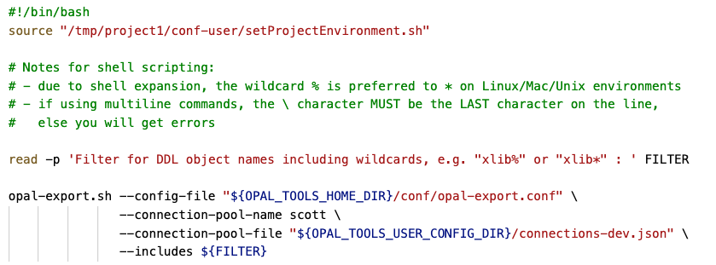
The Solution - EXPORT
opal-export.sh
simple wrapper for the Java application
export-scott-prompt-with-filter.sh
calls setProjectEnvironment.sh first
Prompts for like-filter of db objects
Uses the connection pool for the development environment

Slide 14
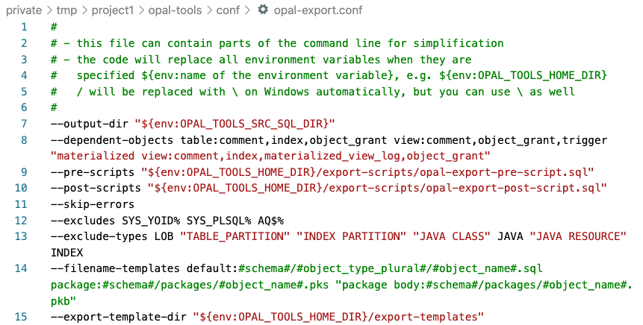
The Solution - EXPORT
Folder „opal-tools/conf“
Config files for the logging
Config file for global settings

Slide 15
The Solution - EXPORT
Folder „opal-tools/export-scripts“
Run before or after exporting the DDL for the selected objects

Slide 16
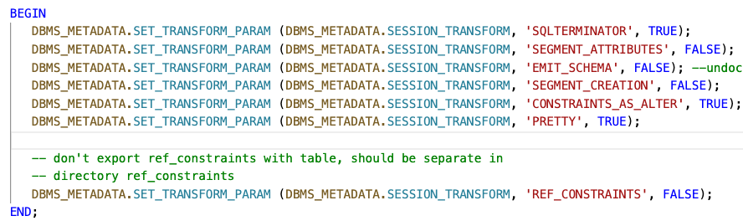
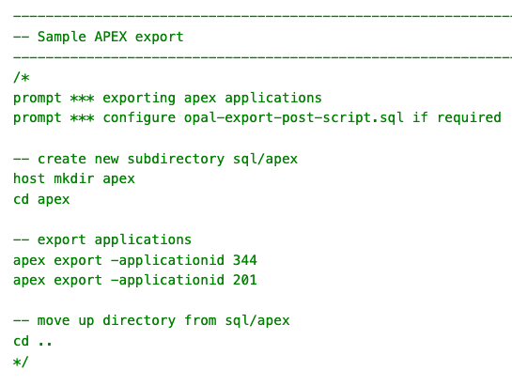
The Solution - EXPORT
opal-export-pre-script.sql
opal-export-post-script.sql

Slide 17
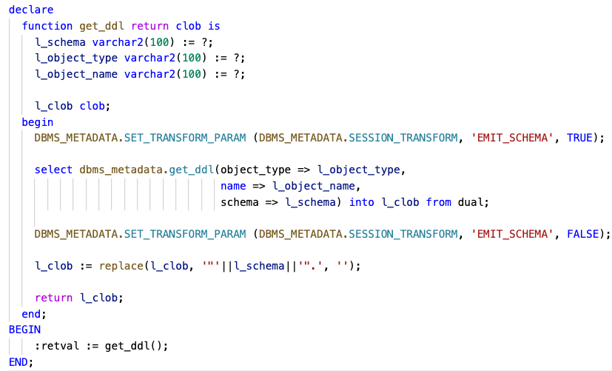
The Solution - EXPORT
Folder „opal-tools/export-templates“
Override the general call to dbms_metadata.get_ddl()

Slide 18
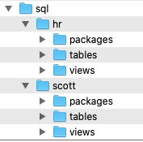

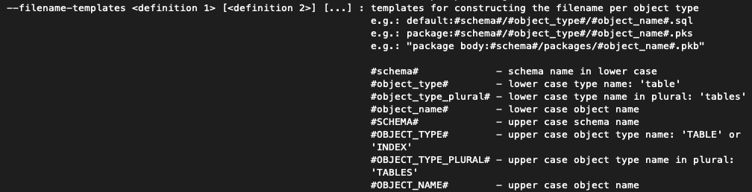
The Solution - EXPORT
Folder „sql“
Export of database object into files

Slide 19
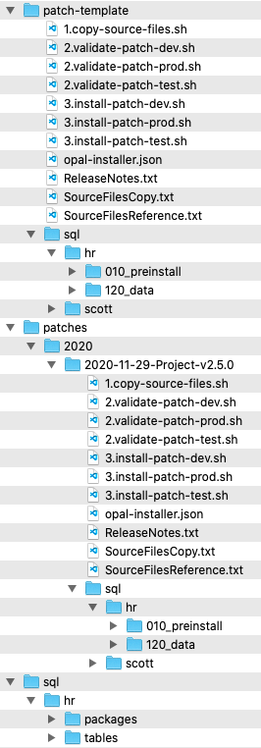
The Solution - INSTALLER
Folder „patch-template“
Will be used as a template for a new patch (copy directory and subdirectories)
Folder „patches“
<year>/<year-month-day>-<patch name> is generated through the batch script initialize-patch.sh
Folder „sql“
sql source files

Slide 20
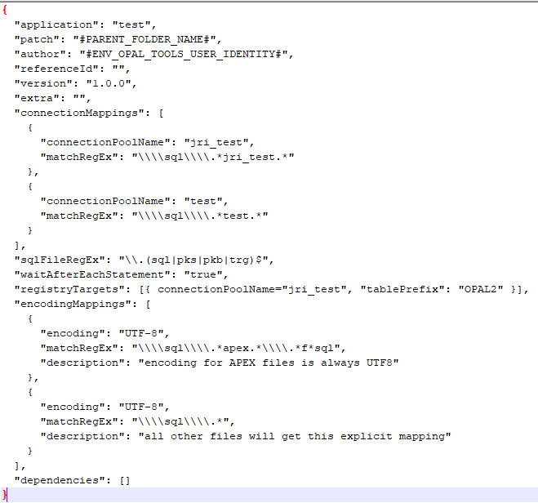
The Solution - INSTALLER
Config file for the patch: opal-installer.json

Slide 21

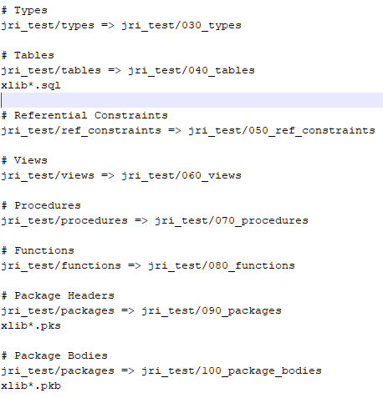
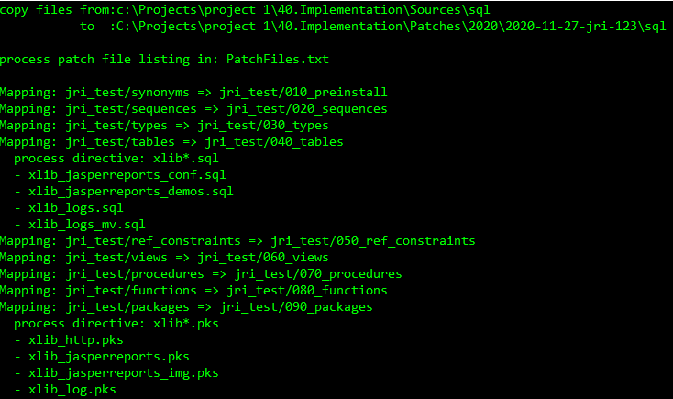
The Solution - INSTALLER
1.copy-source-files.sh
Copies files from the source tree to a target tree

Slide 22
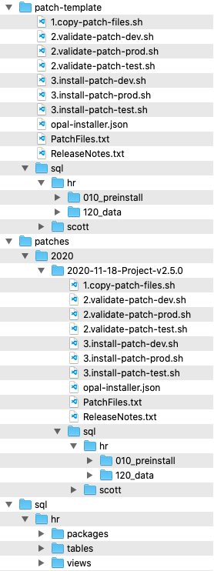
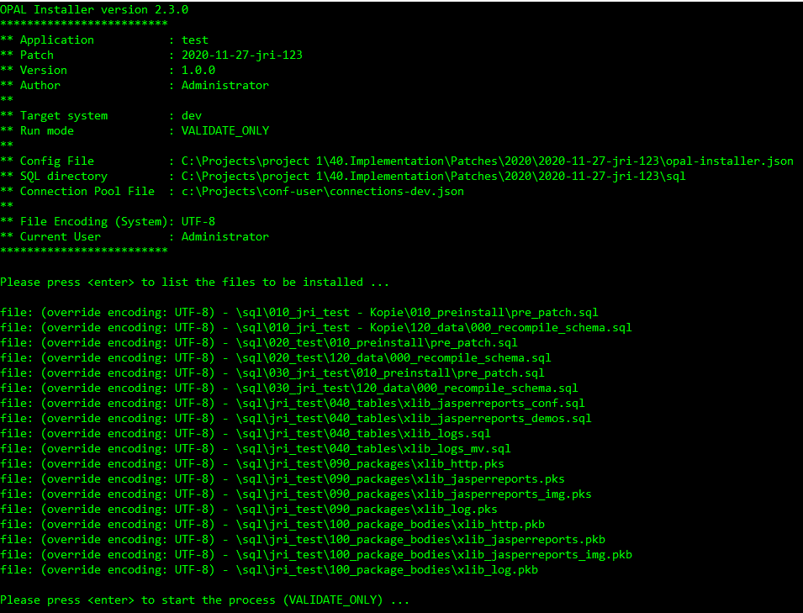
The Solution - INSTALLER
2.validate-<environment>.sh
Validates connection pool and shows files in the order they will be installed

Slide 23
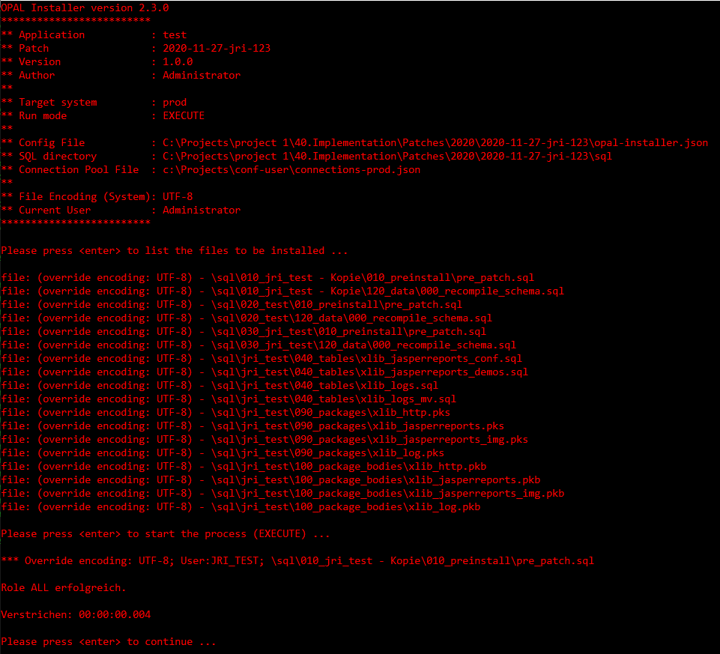
The Solution - INSTALLER
3.install-<environment>.sh

Slide 24

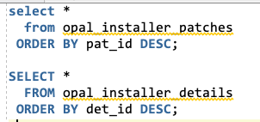
The Solution - INSTALLER
ReleaseNotes.txt
Plain text file
When it exists, will be inserted into patch table

Slide 25
Demo
Notes:
Drag your picture and Send to Back

Slide 26
Customization
Notes:
Drag your picture and Send to Back

Slide 27
Customization
EVERYTHING should be customizable
No approach is forced, no directory layout is assumed
Shell scripts are pre-generated, can and should be adapted to your needs
Patches are based on the patch-template folder, make changes there
Everything is driven by command-line switches

Slide 28
Download / GitHub
Notes:
Drag your picture and Send to Back

Slide 29
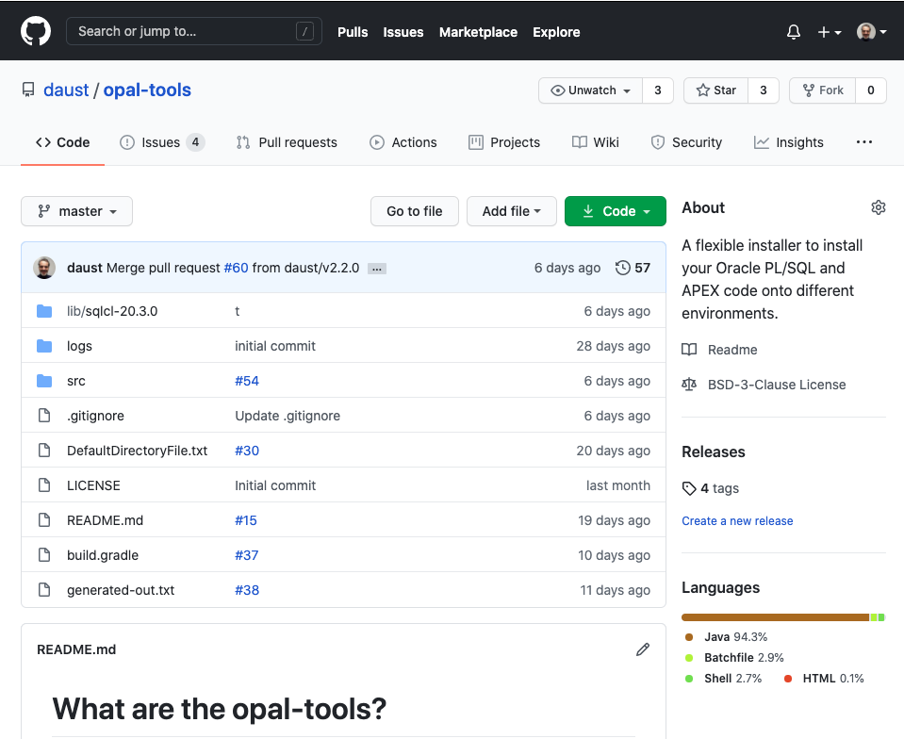
https://github.com/daust/opal-tools

Slide 30
Questions?
Opal Consulting
Email / Website
Zum Tilmeshof 11
50859 Köln
Germany
dietmar.aust@opal-consulting.de
www.opal-consulting.de

